Slide 1
Module 1:
Introduction to Azure Concepts and Core Azure Services

Slide 2
Module 1: Lesson 7:
Introduction to Azure Cosmos DB and Azure Database

Slide 3




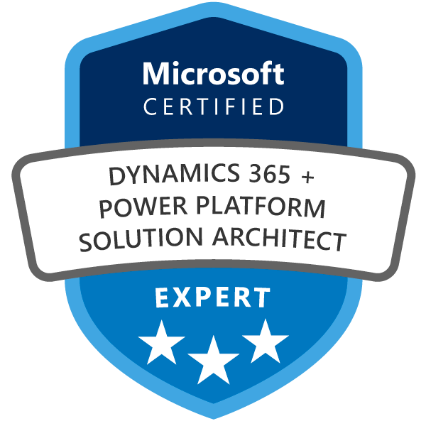
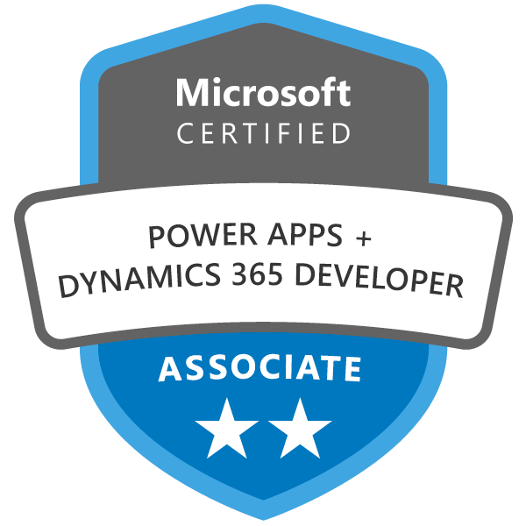

About The Presenter
Phil Cole
Consultant, DXC Technology
Dynamics 365 and Power Platform Consultant
Certified Dynamics and Power Platform Solution Architect (MB-600)
Community Builder, Opensource Contributor
Electric Car and Home Automation Enthusiast

Slide 4


Lesson 7: Overview
This lesson will cover
Introduction to Azure Cosmos DB
Creating an Azure Cosmos DB
Introduction to Azure SQL Database
Creating an SQL database

Slide 5

Cosmos DB
Globally distributed, multi-model database service.
Elastically scale throughput and storage across Azure regions worldwide
Accessible via multiple popular APIs
Core (SQL), Mongo, Cassandra, Azure Table, Gremlin
SLAs for throughput, latency, availability and consistency
Schema-less data – ‘Always On’ application for constantly changing data.
Launched in 2017, Azure Document DB was migrated into Azure Cosmos DB.
Stores data in the atom-record-sequence (ARS) format, which is abstracted and projected as an API. NoSQL.
NoSQL alternatives: Amazon DynamoDB, Crouchbase, Google Bigtable
Notes:
Azure cosmos db is a global distributed, multi-model database service.
Core (SQL) is the recommended/native API – fast, flexible development with familiar SQL query language and client libraries for .NET, JavaScript Python and Java
MongoDB – fully managed database service for apps written for MongoDB. Recommended if you have existing MongoDB workload that you’d like to move to Azure CosmosDB
Cassandra – Fully managed Casandra database service for apps written for Apache Cassandra. Recommended for migrating existing Cassandra workloads to Azure Cosmos DB
Azure Table – Fully managed database service for apps written for Azure Table storage. Recommended if you have existing Azure Table storage workloads that you plan to migrate to Azure Cosmos DB, but do not want to re-write your application to use the SQL API
Gremlin (Graph)
Launched in 2017, as a successor to Azure Document DB.

Slide 6
Cosmos DB APIs
API | Summary | When
Core (SQL) | Flexibility of a NoSQL document store plus the power of SQL for querying | Consider for new apps unless data is based on relationships, then consider gremlin
MongoDB | Allows MongoDB clients/applications to use CosmosDB instead of an actual MongoDB database | Existing apps using MongoDB
Cassandra | Allows Cassandra clients/applications with Apache drivers compliant with CQLv4 to use CosmosDB | Existing apps using CassandraDB
Gremlin | Supports graph data with Apache TinkerPop | New apps with data represented in terms of relationships
Table | Provides premium capabilities for existing applications written for Azure Table storage | Existing apps written for Azure Table Storage
Notes:
Apache Tinkerpop is a graph computing framework

Slide 7
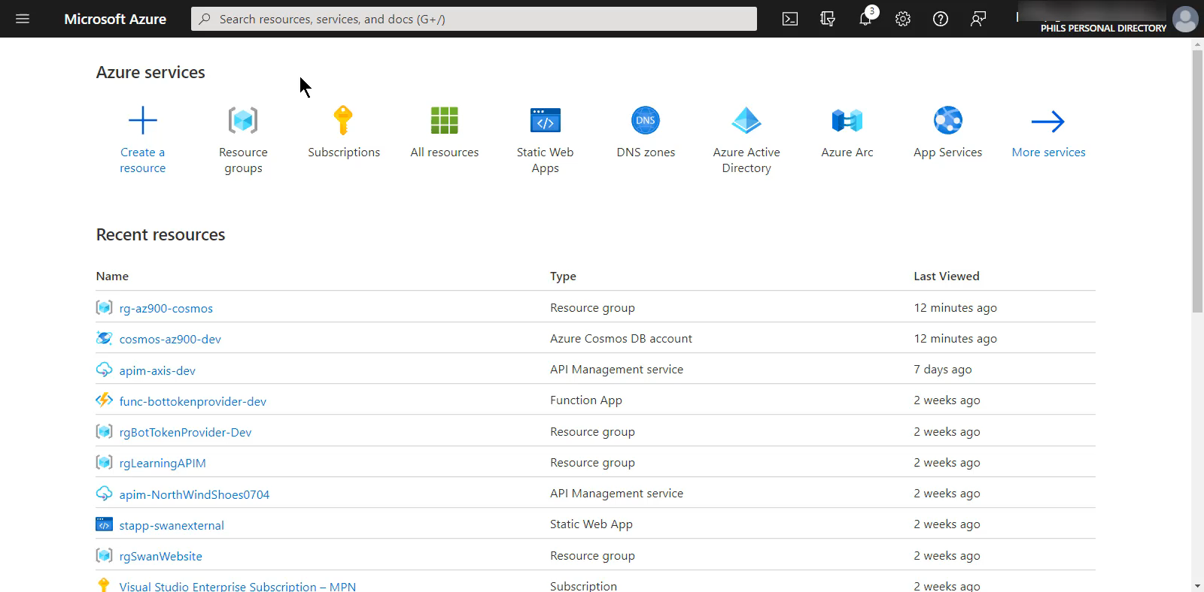
Example Creation
Try Azure Cosmos DB for Free without an Azure subscription, free of charge and commitments or use the Azure Cosmos DB free tier to get an account with the first 1000 RU/s and 25 GB of storage free

Slide 8
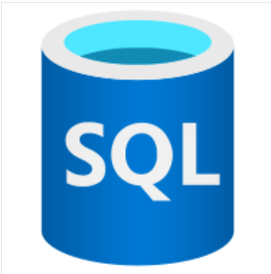
Azure SQL Database
Relational database based on latest stable version of MS SQL Server
Platform as a Service (PaaS) offering
Removes requirement for manual patching, upgrading, backups and monitoring.
Provides 99.99% Availability
Relational Data + Non-Relational Structures (Graphs, Json, spatial, XML)
Advanced query processing features, the newest features are released to Azure SQL Database before SQL Server itself!

Slide 9
Azure Database Migration Service
Migrates existing databases with minimal downtime
The Data Migration Assistant can generate assessment reports, providing recommendations to help guide you through required changes prior to performing a migration
Assess and resolve any issues before beginning the migration
Only connection strings need to be migrated
Notes:
You can migrate your existing SQL Server databases with minimal downtime by using the Azure Database Migration Service.

Slide 10
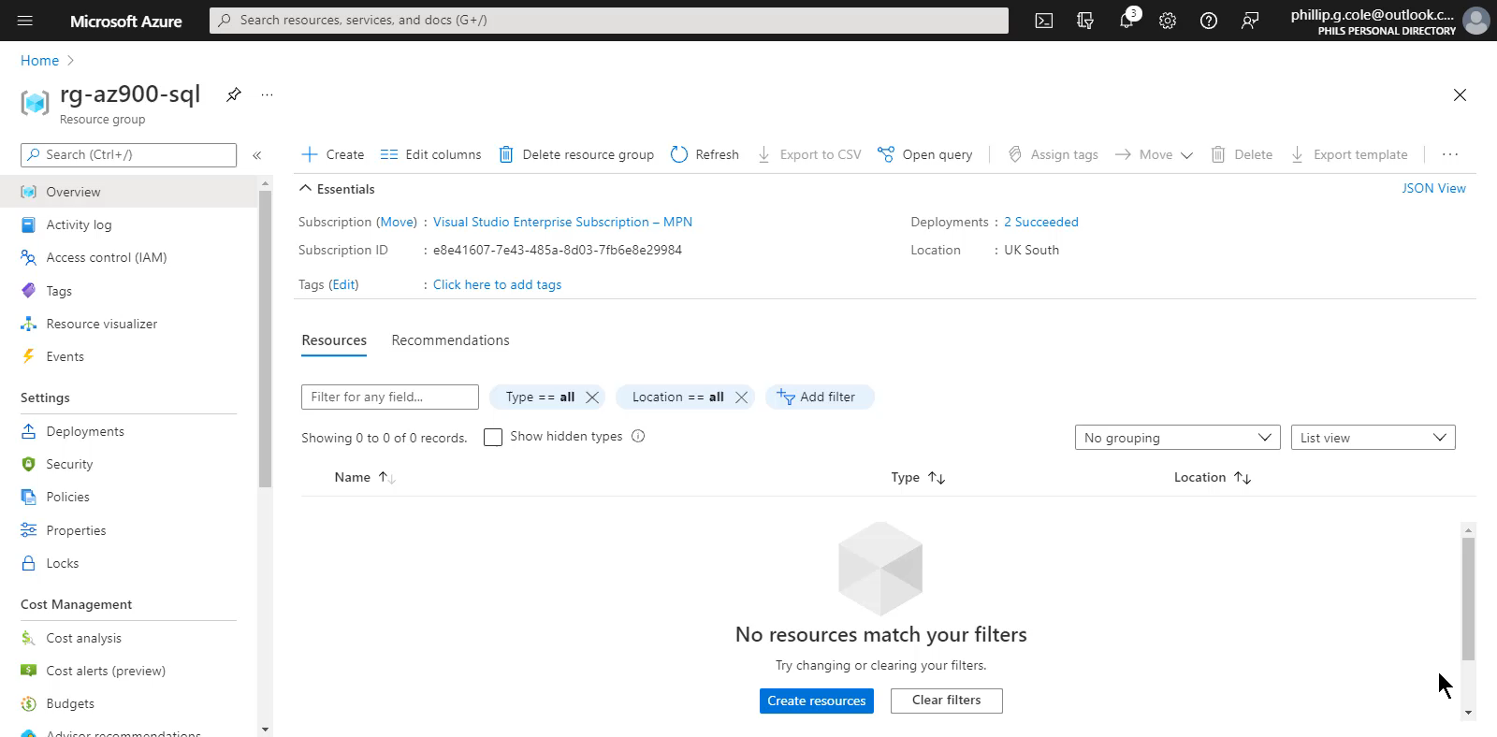
Creating an SQL Database

Slide 11

Summary
This lesson has covered
Cosmos DB Database
Azure SQL Database
Azure Database Migration Service
Example of creating Azure SQL Database
Next Lesson:
Resources: Microsoft Learning
Notes:
How Cloud Can Help DevOps Transformation

Slide 12


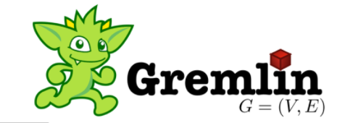
Cosmos DB
Not Only SQL
More flexible than Relation Databases
Schemeless Design
Suitability depends on the problem it must solve
Distributed System consistency based on the CAP Theorem
Consistent
Available
Partition/Fault Tolerant
Consistency
AC
CP
CAP
Partition Tolerance
Availability
AP

Slide 13
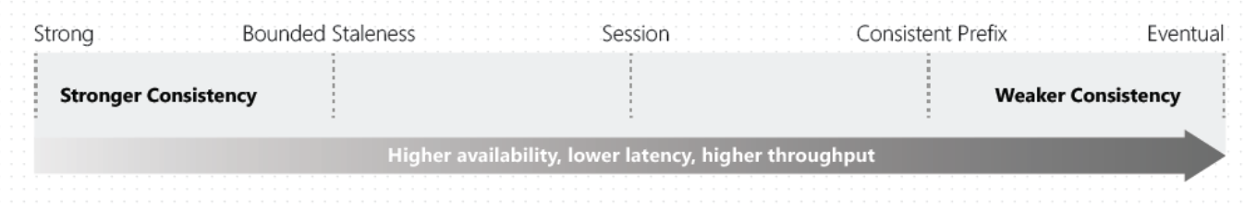
Cosmos DB
Consistency Levels
PACELC Theorem
Supports five tunable consistency levels that allow for tradeoffs between C/A during P, and L/C during E

Slide 14
Cosmos DB
Stores items in containers
Databases
Databases
Databases
Collections
Collections
Collections
Items
Items
Items
Notes:
Cosmos DB stores items in containers. Depending on the API being used these would are surfaced differently
Containers are groupd in “databases” – analogus to namespaces

Slide 15
Cosmos DB
Multi-Model, NoSQL Database Service
SLA, Always On
Consistency levels
Stores data in ARS (Atom-Record-Sequence)
Data is Abstracted over API
Choices: SQL, MongoDB, Cassandra, Tables, Gremlin
Try Azure Cosmos DB for Free without an Azure subscription, free of charge and commitments or use the Azure Cosmos DB free tier to get an account with the first 1000 RU/s and 25 GB of storage free
Notes:
Cannot change the API choice once the database is created

